Slide 1

Dr. Najeed Ahmed Khan
Area of specialization: Artificial Intelligence Computer Vision
Email: najeed@hotmail.com
Department of Computer Science & IT
NED University of Engineering & Technology

Slide 2
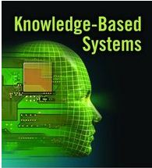
We are here to learn
CT-524
Knowledge Based System

Slide 3
Course
Thursday
1800 – 2100 hrs.
Grading
Sessional 40%
– Assignment / Project, Quizzes, Attendance
Final 60%

Slide 4
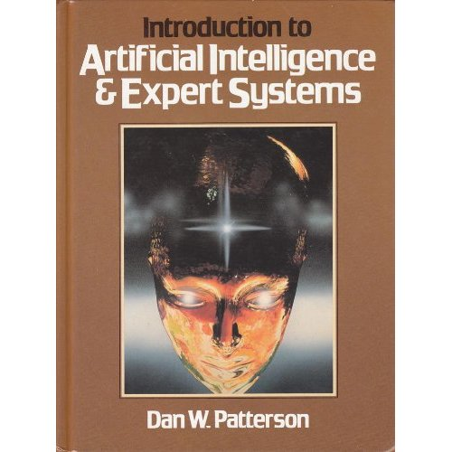
Textbook(s)
Introduction to
Artificial Intelligence And Expert Systems
DAN W. PATTERNSON
Readings from the text
Recommended strongly

Slide 5
Online Resources
My Knowledge based system home page(under work)
- Lecture Slides and other related material https://sites.google.com/site/CT524 Knowledge based/
Online texts and software
http://www.wtec.org/loyola/kb/c1_s1.htm
http://expertise2go.com/webesie/e2gdoc/
http://www.wtec.org/loyola/kb/c3_s2.htm

Slide 6

Introduction to
Our attempt to build Models of ourselves
(Elaine Rich)

Slide 7
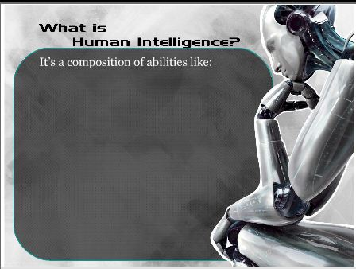

Slide 8
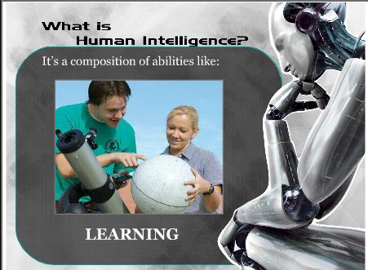

Slide 9
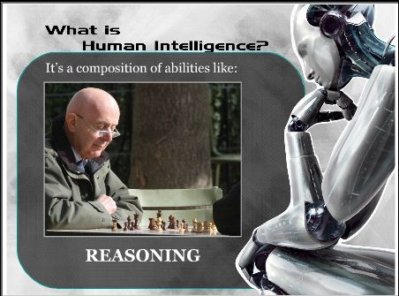

Slide 10
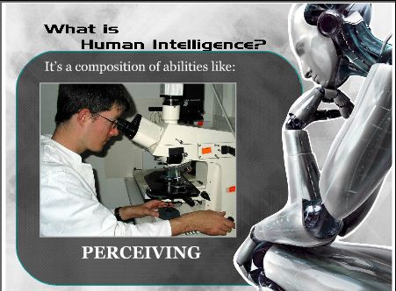

Slide 11
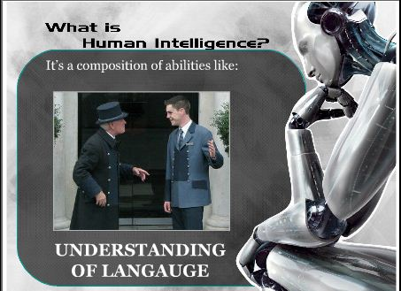

Slide 12
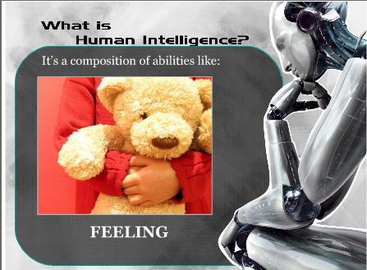

Slide 13
What is human intelligence (Cont)
–Learn from experience
–Apply knowledge acquired from experience
–Handle complex situations
–Solve problems when important information is missing
–Determine what is important
–React quickly and correctly to a new situation
–Understand visual images
–Process and manipulate symbols
–Be creative and imaginative
–Use heuristics

Slide 14
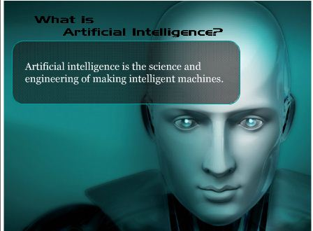

Slide 15

Applications of AI

Slide 16
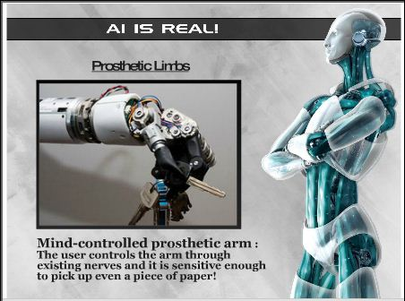
Applications of AI

Slide 17
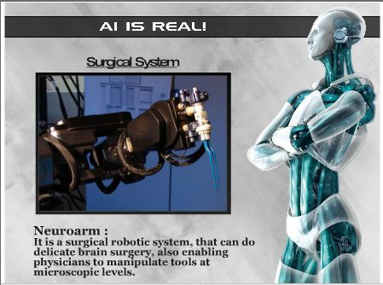
Applications of AI

Slide 18
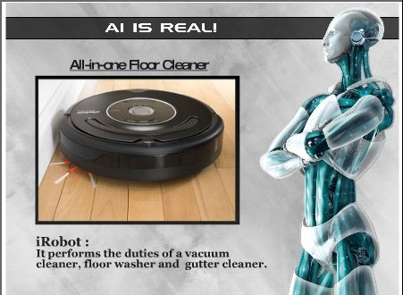
Applications of AI

Slide 19
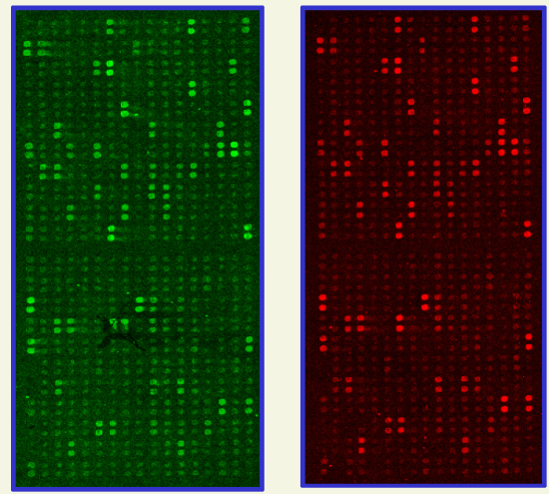
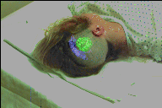
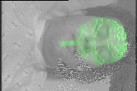
Applications of AI : Medicine/Genetics
• Diagnosis
– radiology - read X rays, CAT scans
– pathology - read biopsies
• Remote and tele-medicine
• Virtual reality surgical assistance
– project images onto head during brain surgery
• Genetics: microarray analysis

Slide 20
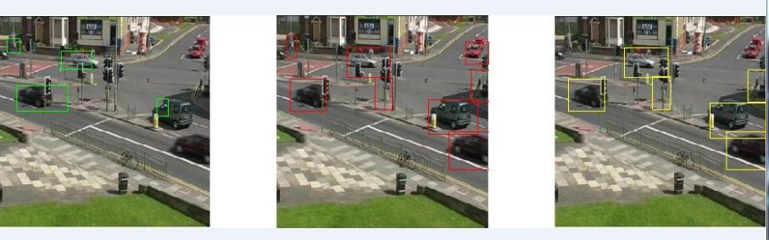
Applications of AI Transportation
• Traffic safety and control
– detection and ticketing of speeding vehicles
– vehicle counting for flow control’
• Robot drivers

Slide 21
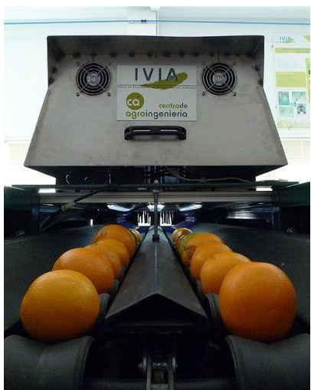
Applications of AI Agriculture
Safety and quality inspection
– sorting by size - Oranges
– sorting by shape - potatoes
– identifying defects:
blemishes on fruit, rot in
potatoes
– disease monitoring - chickens

Slide 22
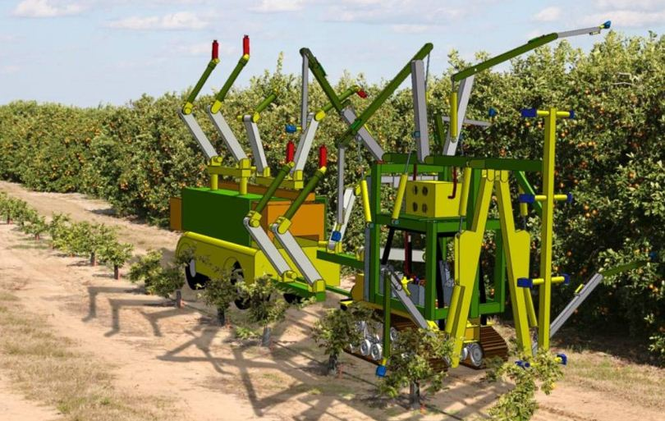
Applications of AI Vision robotics a company in California
• Robotic farming equipment
– robotic harvesters - apple pickers, orange, pickers

Slide 23
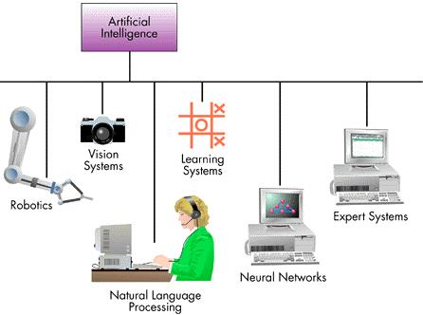
Major Branches of A. I.

Slide 24

Robotics Mechanical and computer devices that performs tedious tasks with high precision.

Slide 25

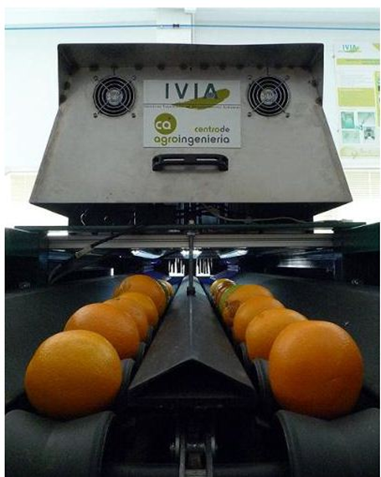
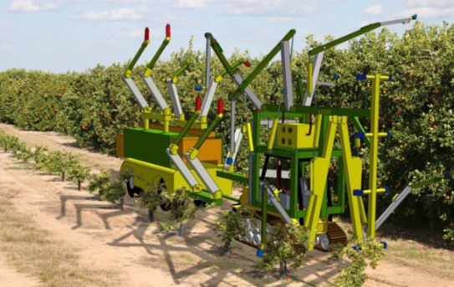
Vision system
Capture, store, and manipulate visual images and pictures

Slide 26
Natural Language Processing
Computers understand and react to statements and commands made in a “natural” language, such as English.
e.g. Windows 7 OS supports speech recognition

Slide 27
Learning System
Computer changes how it functions or reacts to situations based on feedback.
e.g. Automatic intelligent door system
Intelligent fire alarms

Slide 28
Expert System/Knowledge based system
Stores knowledge and makes inferences.
e.g. Eliza (ES)
H: Men are all alike
E: In what way?
H: They’re always bugging us about something or another.
E: Can you be more specific?
H: Well, my boyfriend made me come here.
E: Your boyfriend made you come here?
H: He says I’m depressed much of the time.
E: I am sorry to hear you are depressed.
H: It’s true. I am unhappy.
E: Do you think coming here will help you not to be unhappy?
H: I need some help, that much seems certain.
E: What would it mean to you if you got some help?
H: Perhaps I could learn to get along with my mother.
E: Tell me more about your family

Slide 29
Knowledge based system (Introduction)
The name Expert Systems was derived from the term knowledge-base expert systems.
An ES is a system that employs human knowledge captured in a computer to solve problems.

Slide 30
History of Experts Systems
The AI community developed Expert Systems as early as the mid 1960s. One attempt in
this direction was the General-purpose Problem Solver. Developed by Newell and Simon 1973

Slide 31
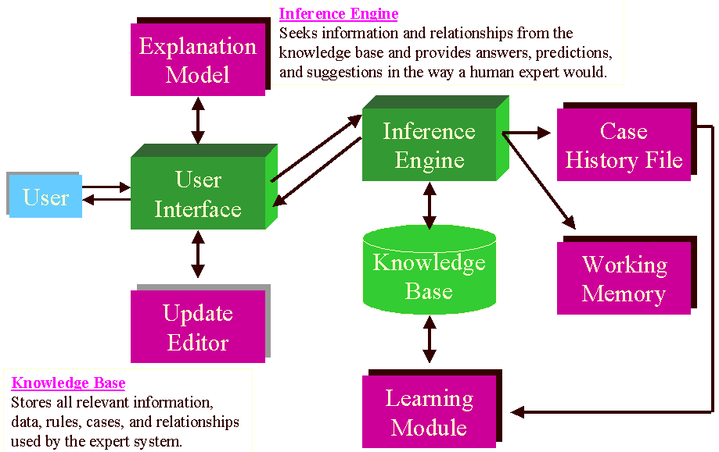
Architecture of Rule-based Expert Systems

Slide 32
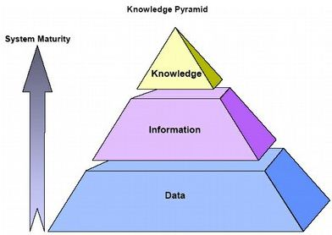
What is Knowledge ?
In the field of information system it is customary to distinguish between:
Data
The term Data refers to numeric (or alphanumeric) string that by them does not have a meaning. They can be facts and figures to be processed.
Information
Information a data organized so that it is meaning full to the person receiving it.
Knowledge
According to the Webster’s New Dictionary of the American Language, knowledge is:
· A clear and certain perception of something.
· Understanding
· Learning
· All that has been perceived or Grasped by the mind
· Practical experience skill
· Acquaintance or familiarity.
· Recognition,
· Organized information applicable to problem solving

Slide 33


Level of Knowledge
Shallow Knowledge
Surface level knowledge use solve low-level problem can be expressed by IF THEN rule.
E.g., IF here is no fuel in the fuel tank THEN engine will not turn over.
Deep Knowledge
Human beings use deep level knowledge for solving complex problem. Like doctor
diagnose disease of patient. An automobile engineer determines the problem.

Slide 34
Deep Knowledge Investigation

Slide 35
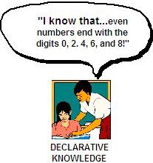
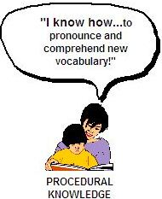
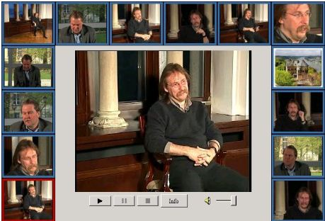
Categories of Knowledge
Declarative Knowledge
Declarative knowledge is a descriptive representation of knowledge.
It is expressed in a factual statement.
E.g. “There is positive association between smoking and cancer”.
Procedural Knowledge
Procedural knowledge step-by-step sequences and how-to types of
instructions
Heuristic Knowledge
Derived from the Greek word for “Discovery”. Depends on our experience, judgments,
tricks etc.
Meta Knowledge
Knowledge about knowledge

Slide 36
Source of Knowledge
Knowledge may be collected from many sources.
Books, News papers, Computer, Databases
Films, Pictures
Maps, Flow diagram
Stories, Experiences
Observed behavior

Slide 37
Experts
Experts should be able to explain the results, learn new things about the domain,
restructure knowledge whenever needed, break rules whenever necessary (i.e., know the
exceptions to the rules), and determine whether their expertise is relevant.
Human expertise includes a constellation of behavior that involves the following
activities:
• Recognizing and formulating the problem
• Solving the problem quickly and properly
• Explaining the solution
• Learning from experience
• Restructuring knowledge
• Breaking rules
• Determining relevance
• Degrading gracefully
Transferring expertise
The objective of an expert system is to transfer expertise from an expert to compute and
then on to other humans (non-experts). This process involves four activities:
• Knowledge acquisition (from experts or other sources)
• Knowledge representation (in the computer)
• Knowledge inferencing
• Knowledge transfer to the user
Inferencing
Given that all the expertise is stored in the knowledge base and that the program has
accessibility to databases, the computer is programmed so that it can make inferences.
The inferencing is performed in a component called the inference engine, which includes
procedures regarding problem solving.
Inferencing rules
Most commercial ES are rule-based systems; that is, the knowledge is stored mainly in
the form of rules, as are the problem-solving procedures. “IF, the engine is idle, and the
fuel pressure is less than 38 psi, and the gauge is accurate, THEN, there is a fuel system
fault.”
Explanation capability
Another unique feature of an ES is its ability to explain its advice or recommendations
and even to justify why a certain action was not recommended.
The explanation and justification is done in a subsystem called the justifier, or the
explanation subsystem.

Slide 38
History of Experts Systems
The AI community developed Expert Systems as early as the mid 1960s. One attempt in
this direction was the General-purpose Problem Solver. Developed by Newell and Simon
1973

Slide 39
Eliza (ES) Sample dialog:
This system would act like a psychoanalyst by holding a dialog with a person
the dialog would be consist of the doctor (Eliza) asking questions, the human responding, and the doctor using the response to ask another question
H: Men are all alike
E: In what way?
H: They’re always bugging us about something or another.
E: Can you be more specific?
H: Well, my boyfriend made me come here.
E: Your boyfriend made you come here?
H: He says I’m depressed much of the time.
E: I am sorry to hear you are depressed.
H: It’s true. I am unhappy.
E: Do you think coming here will help you not to be unhappy?
H: I need some help, that much seems certain.
E: What would it mean to you if you got some help?
H: Perhaps I could learn to get along with my mother.
E: Tell me more about your family

Slide 40
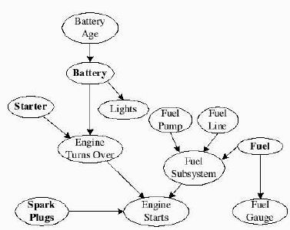
A Bayesian Network for an automobile troubleshooting program

Slide 41
Types of Expert Systems
Model–based Expert Systems
• Model-based reasoning is based on knowledge of the structure and behavior of the
devices.
• Model-based systems are especially useful in diagnosing equipment problems.
Rule-based Expert Systems
• Depends on Knowledge,
• Tricks
• Logics
• Judgments of related domain to problem diagnose
• Find the solution of the problems.

Slide 42
The idea is to diagnosis the most probable reasons for automobile start-up problems and evaluate the probability that the engine works, when we fix a certain component. For example if we observe that the gauge is empty (whether or not there is fuel), we can calculate the probability that the car starts after we filled the tank.

Slide 43
Why ESs are useful
Help if expertise is scares, expensive or unavailable – where the training new human experts is time –consuming and expensive
Save time , b/c they are fast and same system can serve several users parallely.
Do not forget or make human-like errors.
Are consistent : similar situations are always handled in the same way.
Can combine knowledge of multiple human experts.

Slide 44
However, Ess
Are totally dependent on their knowledge base
Usually manage only one way of reasoning
Don’t have common sense!
Cannot adapt to new situations creatively like human can
Don’t recognize when no answer exists or when the problem is outside their area or domain

Slide 45
Expert System Main Components
Knowledge base
I Obtainable from books, magazines, knowledgeable persons, etc.
Inference engine
I Draws conclusions from the knowledge base

Slide 46
Representing the Knowledge
The knowledge of an expert system can be represented in a number of
ways, including IF-THEN rules:
IF you are hungry THEN eat

Slide 47
Shallow knowledge – based on empirical and heuristic knowledge.
Deep knowledge – based on basic structure, function, and behavior of
objects.

Slide 48
Examples of Expert Systems
Early Expert Systems
DENDRAL – used in chemical mass spectroscopy to identify chemical
constituents
MYCIN – medical diagnosis of illness
DIPMETER – geological data analysis for oil
PROSPECTOR – geological data analysis for minerals
ELIZA

